Slide 1
Image classification
Submitted by : Utsav Rastogi

Slide 2
Problem Statement
Our dataset consists of 3 labels of Apparels such as Saree (Women), Jeans (Men) and Trousers (Men).
This project aims to implement Deep Learning algorithms transfer learning using VGG-16, VGG-19 and Resnet.
Data used in this project are online products collected from “amazon.com” and “flipkart.com.
The Images have been scraped from these websites using Selenium

Slide 3
Data collection
Data has been scrapped using Selenium web driver with python. Selenium is a powerful tool for controlling web browsers through programs and performing browser automation.
Our data has been retrieved from online shopping sites which consists of Fashion Apparel Images such as Men’s Jeans, Trousers and Women’s Saree.
Our dataset consists Images of the product. Equal images were retrieved of each of the three categories to create a balanced dataset and overcome overfitting/underfitting of any particular label.
Training set: Amazon.in (total: 742 images)
Test set: Flipkart.com (total: 356 images)

Slide 4
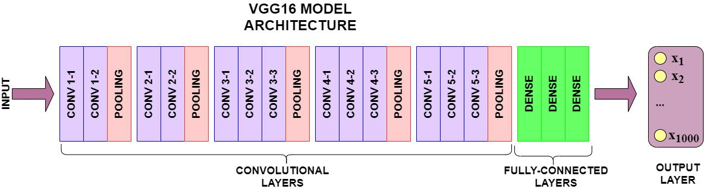
VGG16 model
VGG-16 model architecture – 13 convolutional layers and 2 Fully connected layers and 1 SoftMax classifier VGG-16 - Karen Simonyan and Andrew Zisserman introduced VGG-16 architecture in 2014 in their paper Very Deep Convolutional Network for Large Scale Image Recognition. Karen and Andrew created a 16-layer network comprised of convolutional and fully connected layers. Using only 3×3 convolutional layers stacked on top of each other for simplicity.

Slide 5
process
Loading the libraries
Loading data
Loading the model with no last layer
Not letting the layers of the transfer models train and
The same weights need to be used
The output from the transfer model is flattened.
Locating the folders of the scrapped images
The folder of images is appended as Dense layer to the flattened Transfer model.
This is passed to the Softmax activation function

Slide 6
process
Model is created with the back propogation occurring
Compiling the model with the optimum optimiser, Loss calculation method and metrics used to understand the accuracy of prediction
Image augmentation techniques is used to increase the size of the data but making sure the quality of data is not compromised
Applying the trained model on the test data and finding the accuracy

Slide 7
Hardware/software requirements
Hardware requirements:
RAM: 16 GB
CPU: Intel® Core™ i7-6500U CPU @ 3.10GHz
GPU: NVIDIA- GeForce GTX 960M
Software requirements:
Programming language: Python
Distribution: Anaconda Navigator
Browser based language shell: Jupyter Notebook
Libraries: Pandas, NumPy, matplotlib, keras, TensorFlow

Slide 8
models
Models used in this project are as follows:
VGG16
VGG19
Resnet

Slide 9
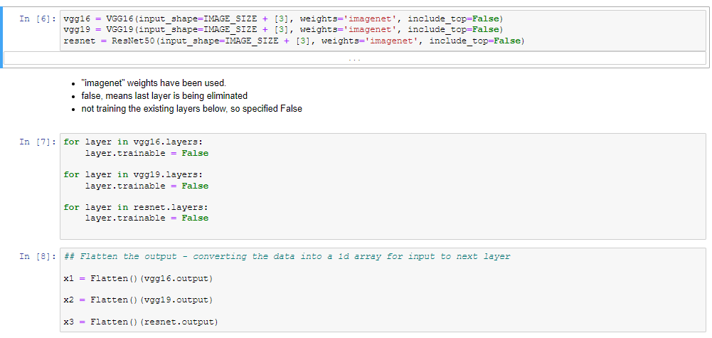
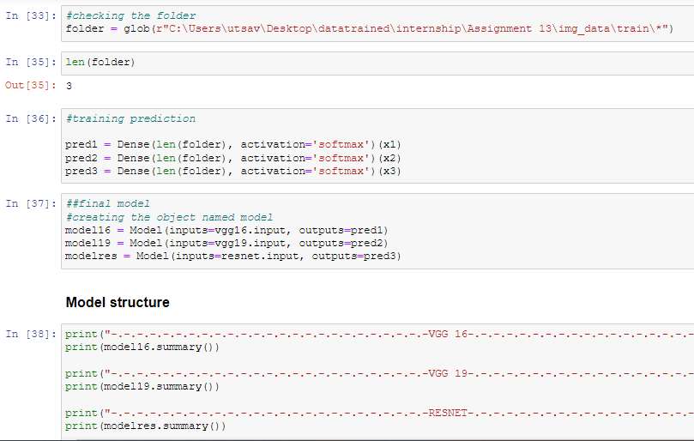
Code snippet

Slide 10
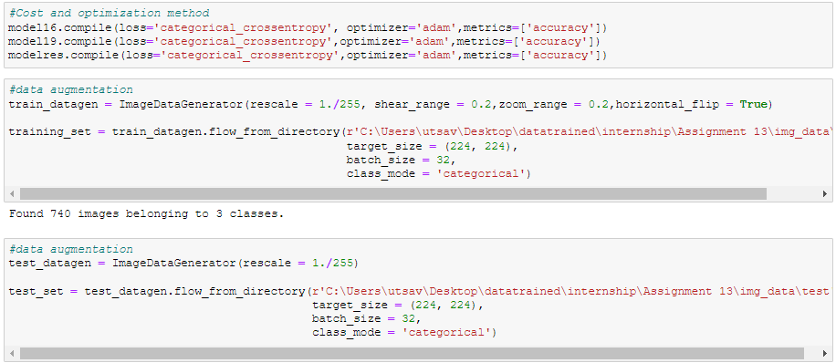
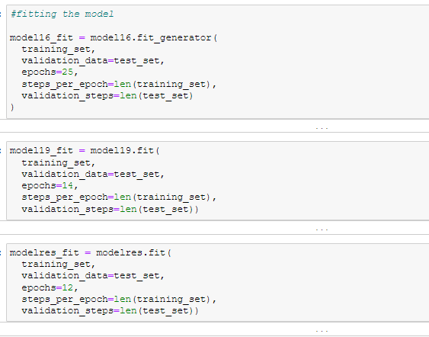
Code snippet

Slide 11
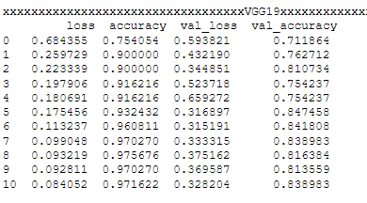
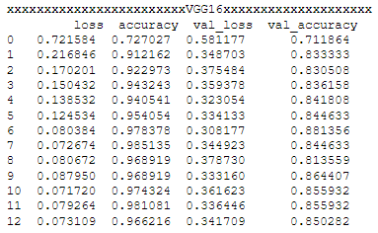
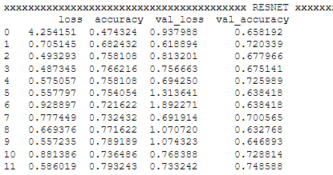
evaluation
VGG19 accuracy and loss
VGG16 accuracy and loss
Resnet accuracy and loss

Slide 12
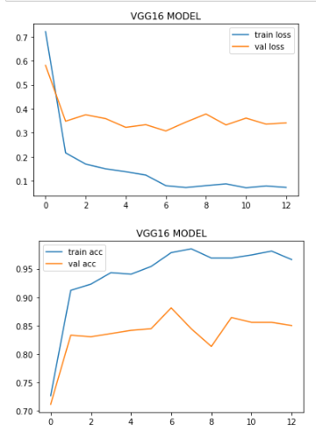
visualization
I chose to plot the graph for VGG16 model because the average val_accuracy is 83+% which is the best among all the models

Slide 13
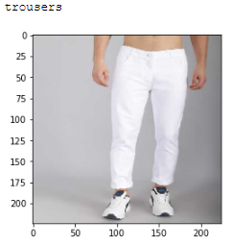
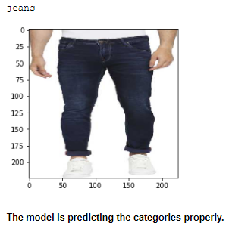
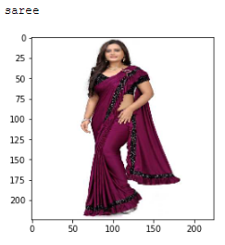
Prediction using vgg16

Slide 14
conclusion
This research evaluated the image classification of fashion apparel using deep learning models. Using real time data, we compared three models VGG16, ResNet and VGG19 using transfer learning with Keras by performing detailed experimental analysis while classifying the Image detected into 3 categories.
VGG16 outperformed other models and is able to classify the images into correct categories with a high average accuracy of 83+%

Slide 15


